Slide 1
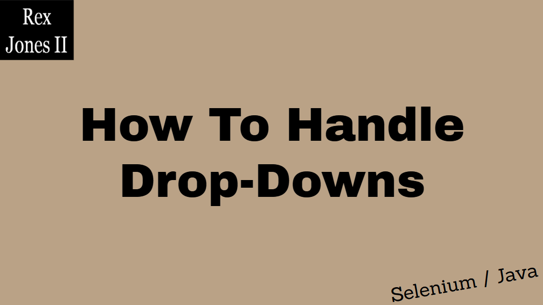

Slide 2
How To Handle
Drop Downs
Trainer: Rex Jones II

Slide 3

Tutorial
Video Series
Select Values From A Drop-Down
Get Values From A Drop-Down
Deselect Values From A Drop-Down
Rex Jones II

Slide 4
Tutorial
Video Series
Select Values From A Drop-Down
Get Values From A Drop-Down
Deselect Values From A Drop-Down

Slide 5
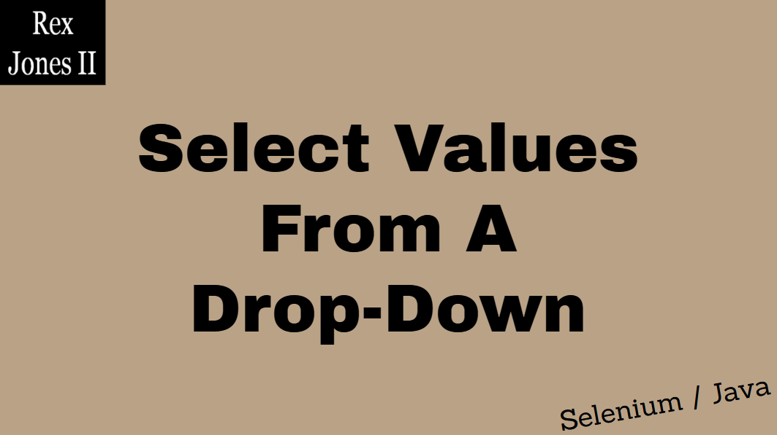

Slide 6
DEMO

Slide 7


Slide 8
Tutorial
Video Series
Select Values From A Drop-Down
Get Values From A Drop-Down
Deselect Values From A Drop-Down

Slide 9
DEMO

Slide 10


Slide 11
Tutorial
Video Series
Select Values From A Drop-Down
Get Values From A Drop-Down
Deselect Values From A Drop-Down

Slide 12
DEMO

